Slide 1
ARLNL Project
Shubham Thakkar, Jorge Munoz
Link to Project: https://apex.oracle.com/pls/apex/f?p=71610:1:1011166457359:::::

Slide 2
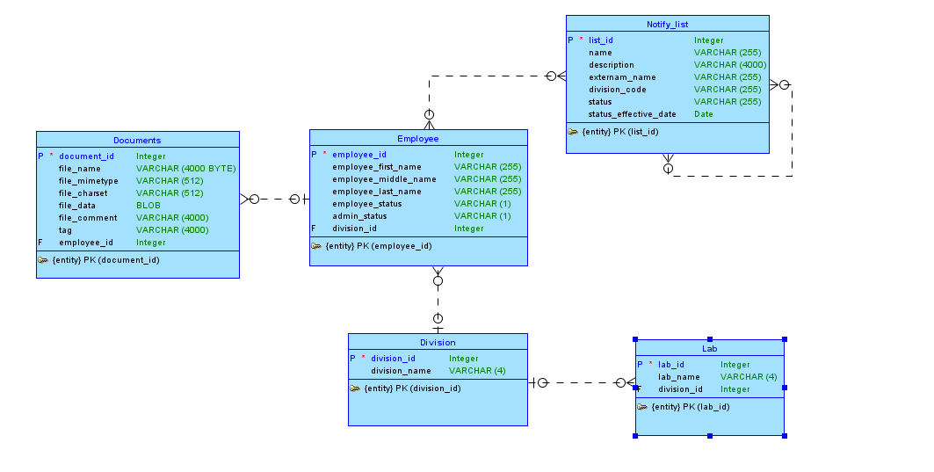
Conceptual Model
Notes:
Employee table will be their table but it is simulated to give a better picture
Lists will be made of employees(M-M) and other lists(M-M)
Users will be able to access lists and modify them based on security clearance
If a query is made for all members in a list, then you will make a query to all the employees in the list and join that with the the employees of the sub lists.

Slide 3
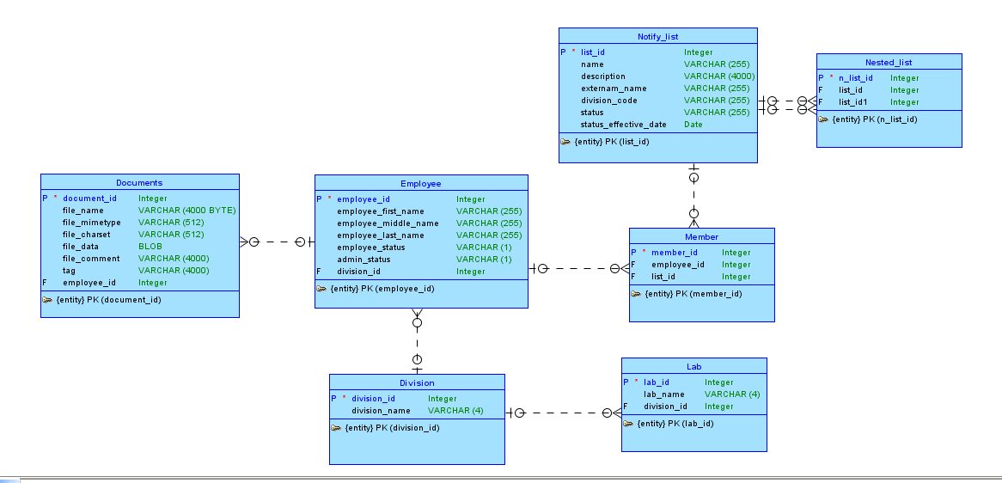
Logical Model
Notes:
Removed the many to many into a separate entities

Slide 4
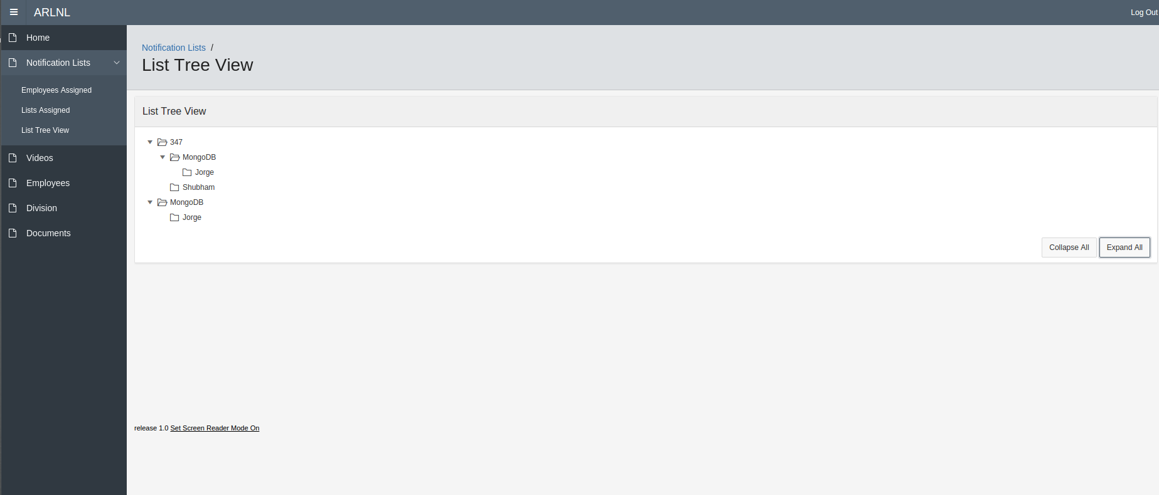
Tree with nested notification lists (nodes) along with users to provide a visual representation of the system 347 & MongoDB are lists. Rest are Users

Slide 5
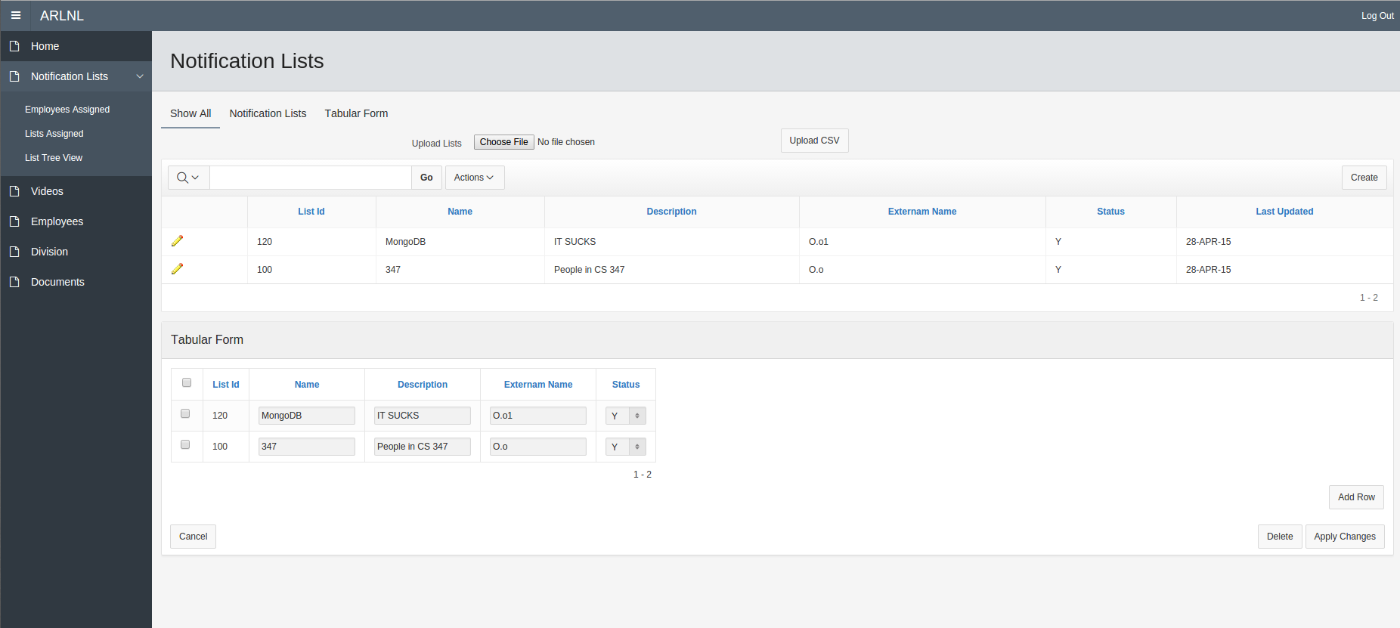
Search Bar and Download CSV are in the report
Upload via a CSV is taken shown with the “Choose File” Button
Tabs allow a user to only see tabular or report for convenience
Tabular form for mass delete

Slide 6
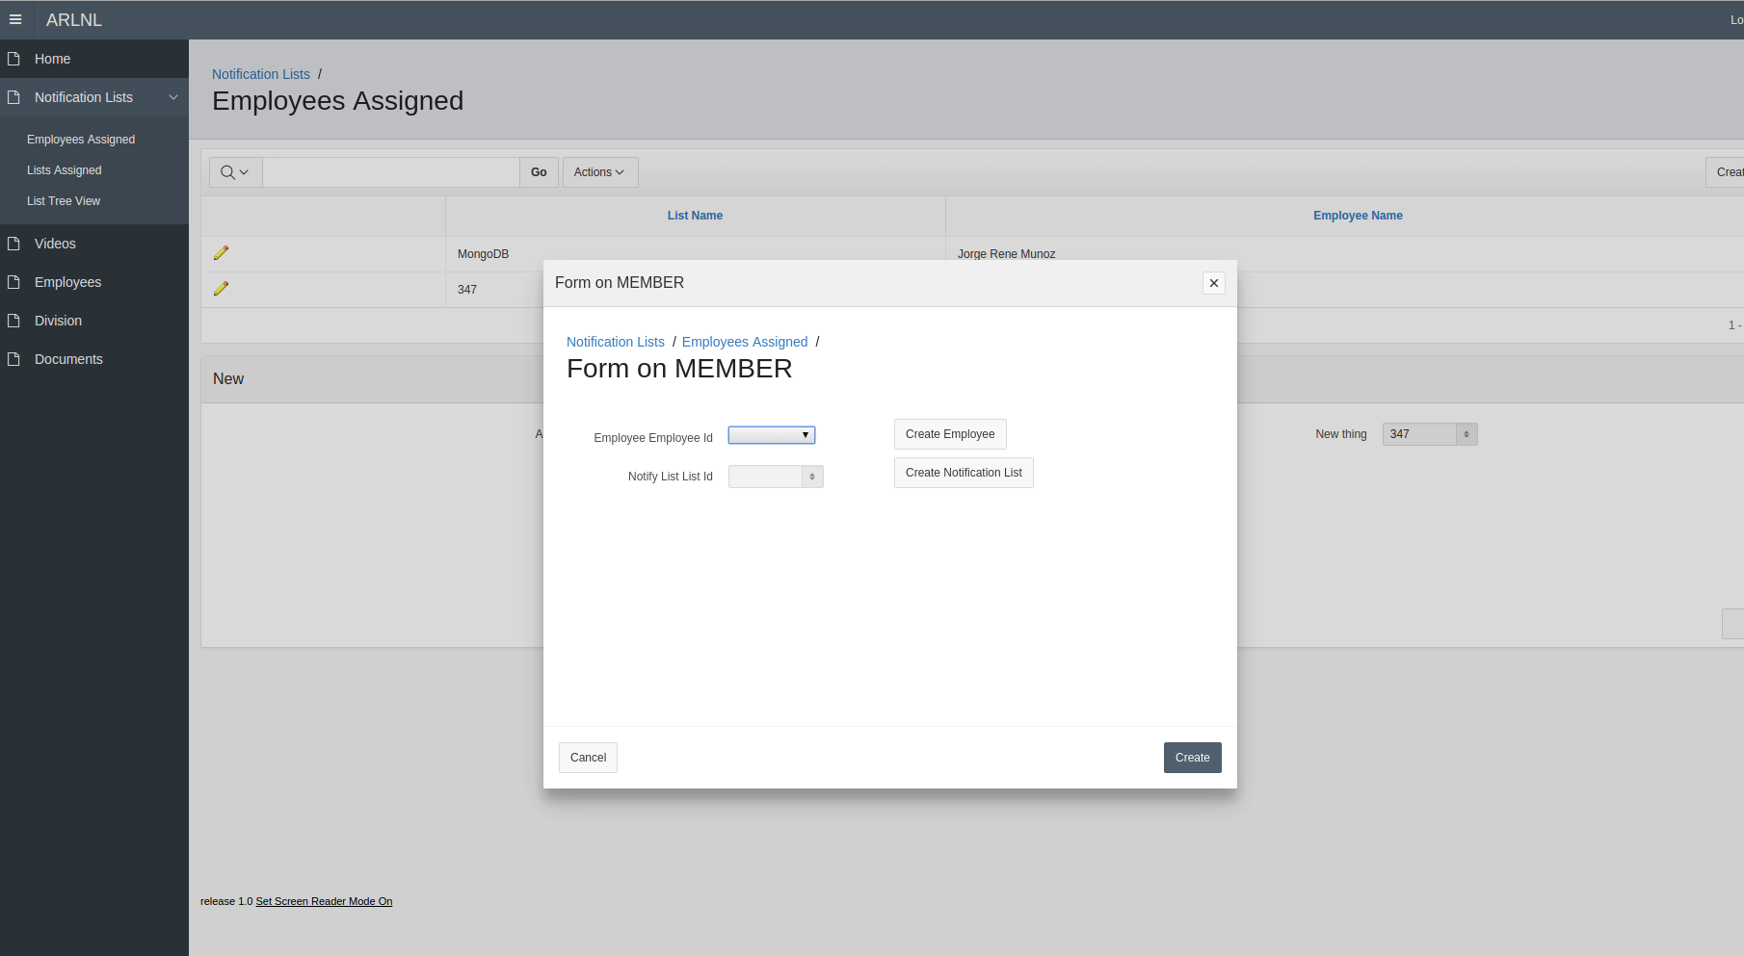
Form to enter a new member
Has the Group Select List for a better visual representation
Buttons to lead you to the employee and notification list create

Slide 7
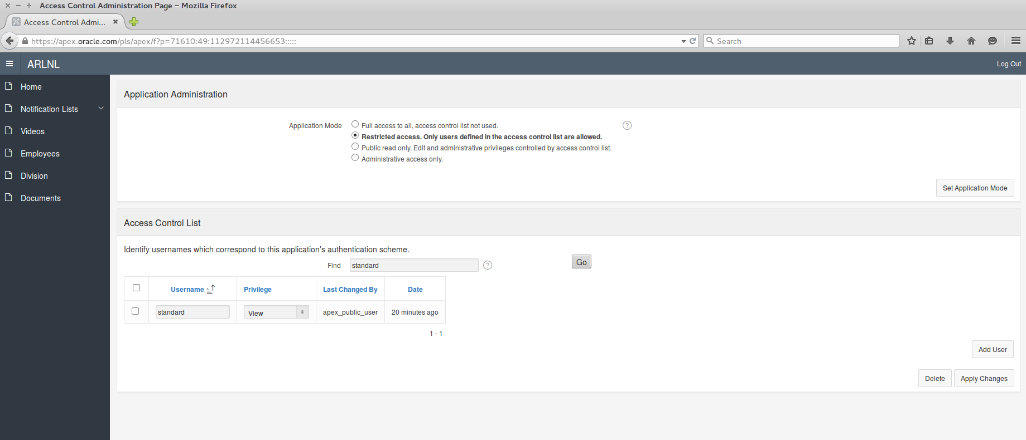
Created access control list in which allow to modify user application and lets user see which ever page you want to see. For now we have it to full access.

